Slide 1
Pre-graduation brief
Download a ‘Check-Out Sheet’ from the NPS Student Forms Webpage
https://nps.edu/web/students/forms
Soon it will be time to depart… so prepare NOW!

Slide 2
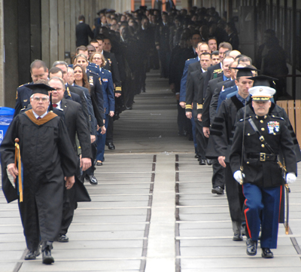
Pre-graduation brief
Student Services Office

Slide 3
What to do and expect
All U.S. military students
Begin Check-Out Sheet
turn in to student services at check out via email
most offices support check out virtually
Staying in Monterey >7 days after graduation..?
submit DOS Request Form
inform Program Officer, Service Representative, etc.
Thesis extension..?
submit Thesis Extension Request
if in doubt, submit thesis extension request to be safe
NPS account access remains active for 90 days after check out, unless needed for exceptional circumstances. (POC: NPS TAC)
Reminder: firearm laws & regulations -- not allowed on base, so plan ahead (if applicable)

Slide 4
Checkout sheet
Checkout items
Library (all)
Student Services (all)
Naval War College (JPME)
Motorcycle Safety (riders only) [email: chris.robare@nps.edu]
Command Fitness (US Navy)
FITREP (US Navy); final copy will be included in transfer packet
Travel Office (all); start now!
Command Security (all)
NPS Registrar (all)
Admin units (all)
Education Technician (all)
Dental/Medical (all)
Urinalysis (all); 1-to-3 days before detaching
Do not start checking out until your final week (except for travel)

Slide 5
Checkout sheet (cont’d)
You are not checked out until your checkout sheet is turned in to Student Services
*turn in 1-to-2 days prior to departure
sa@nps.edu

Slide 6
Medical
NO hand carrying of medical or dental records with the following exceptions:
Service members traveling overseas on permanent change of station orders, that specify records are to be hand carried.
A Medical Treatment Facility Commander determines that it is in the best interest of patient care to allow for hand-carrying of paper medical records.
Service members performing temporary duty where the full medical records are required.
If the service member can provide documentation (i.e. orders) stating they need to hand carry records they will be able to.
If you believe you need to hand carry your records and you do not fall under one of the above criteria, please begin the process early to either have an orders modification or get permission from a MTF Commander.

Slide 7
Security Clearance
Review orders for specific clearance needed to perform your duties in your next command.
Check to see if it is close to expiring or has expired.
See the Security Manager’s Office early to initiate your security investigation.

Slide 8
Common Friction Points
Last minute requests – Tell your Program Officers
Thesis Extensions
Staying >7 Days after PCS Stop movement end date?
Communicate EARLY with your Program Officer!!!
Household goods, medical screenings, and language tests

Slide 9
Travel Office

Slide 11
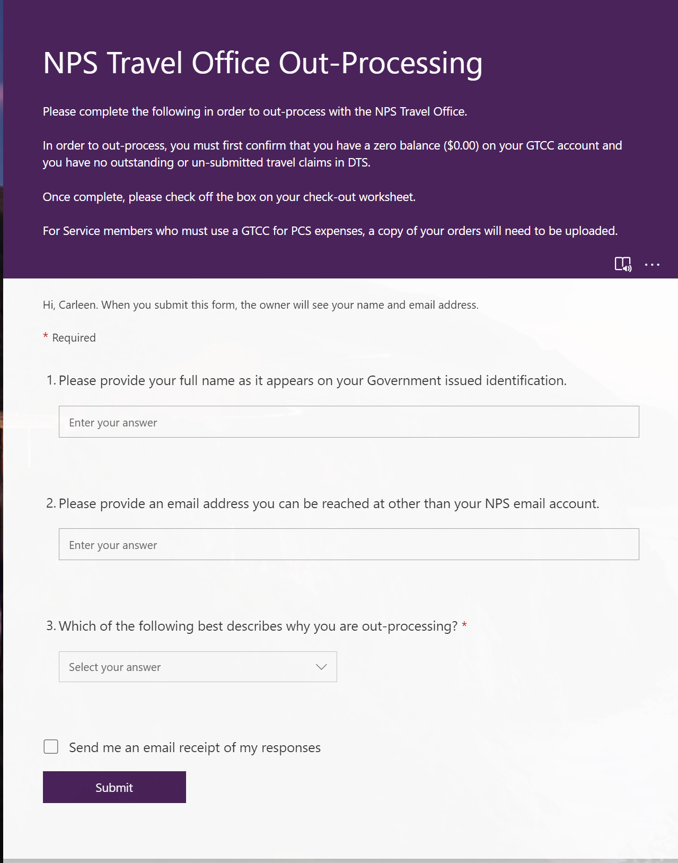

Slide 13
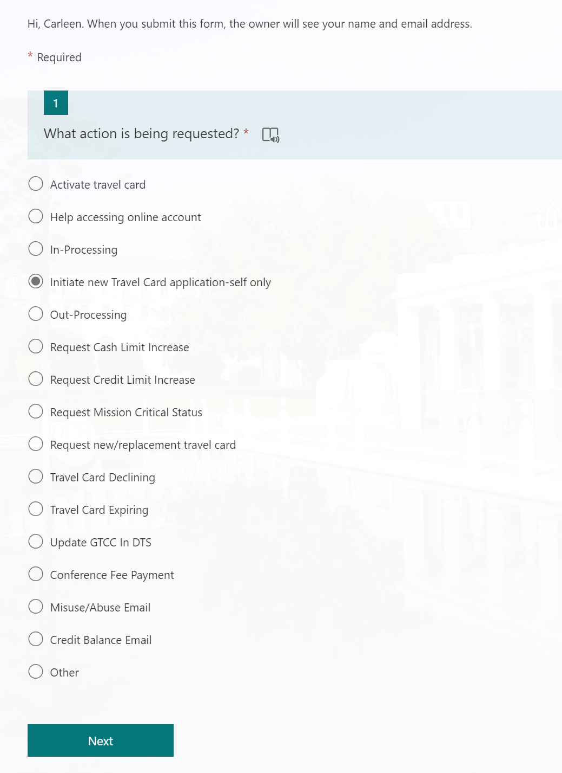

Slide 18
Contact Information
Agency Program Coordinator:
Carleen Wells
ccwells@nps.edu
831-656-2247
Specific PCS Questions
MyNavy Career Center
833-330-6622
askmncc@navy.mil

Slide 19
Navy Transfers
Student Services Office

Slide 20
What to Do & Expect
USN Students
PCS orders can be accessed via NSIPS. If you have any issues, send an email to transfers@nps.edu
No orders? Pending ORDMOD? Contact your Detailer/Update CPPA.
Transfer package forms and instructions (READ THE TRF PKG GUIDE)
Emailed by YNSN Valdez via transfers@nps.edu
Requires expedited completion and submission. Due back to CPPA ASAP or the prescribed due date.
Required for transfer FITREPs preparations.
Transfer paperwork to be processed by TSC Great Lakes/NAVPTO/TPD Memphis (PCS-TDY advances).
There is a current backlog for PCS ADV request processing. Recommend use of GTCC.
Provide timely FITREP Inputs and Transfer updates or changes to:
transfers@nps.edu (copy on ALL correspondence regarding your transfer)
npsfitreps@nps.edu

Slide 21
Transfer Packages
Any transfer date changes after submission of transfer packages to the CPPA will not be approved unless there are extenuating circumstances beyond the MBR's control (short fused ORDMOD, family emergencies). No changes to scheduled Gov Air transportation arranged and booked by NAVPTO Bangor for personal convenience.
CHOOSE YOUR TRAVEL DATE CAREFULLY!
You cannot leave until all medical and security screening requirements are met.
GOVAIR TVL requests with Leave ICW Official Travel: reroute GOVAIR tickets via SATO only. Call 1-855-744-4655 (M-F 0730 – 1530).
Transfer packets will be ready for pick-up on the day prior to approved transfer dates at Student Services Office. See TRF PKG Guide for info.
If your transfer date falls on a Sunday or Monday, you must coordinate your transfer package pick-up with the CDO/OOD before/during Morning colors on the date prior to.
Tuesday to Friday detach dates – pick up at SSO between 0930-1100 For Saturday detach dates – pick up at SSO between 0930-1100 on Friday
Sunday and Monday detach dates – pick up with CDO between 0730-0800 at the NPS quarterdeck

Slide 22
Transfer Resources
All requests for in-person PCS assistance will be on appointment basis only. Send requests and availability via transfers@nps.edu. Walk-ins can not be accommodated.
Average response time to emails are between 1-4 business days due to high workload/low manning. If emergent, indicate “EMERGENCY” in the email subject line.
Transfer packages will include completed FITREP copy, endorsed orders, completed screenings, security clearance memo, etc.
Please remember travel days start on date stamped on orders.
You will not be allowed to pick up your transfer packet if you have incomplete screenings. You will still be detached on your transfer date. Expect to be charged PCS leave. No exceptions.

Slide 23
Email: sa@nps.edu
Questions

